Slide 1

Chapter 6
Employee Benefits

Slide 2
Employee Benefits
Employee Benefits: includes all compensation other than hourly wages

Slide 3
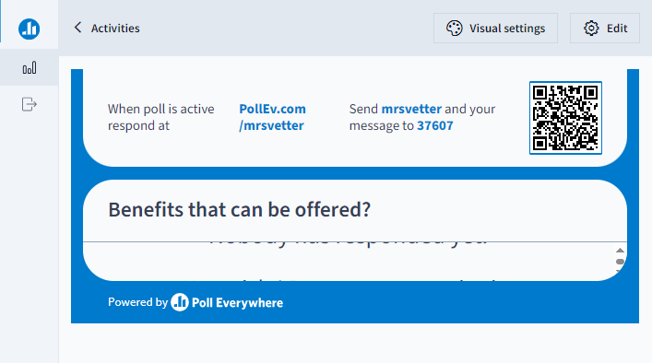
What kind of benefits are offered?

Slide 4
Employee Benefits
Employee Benefits: includes all compensation other than hourly wages
Many benefits beyond a paycheck are offered to full time employees
Some Parttime employees -
Companies compete for employees w/ benefit and incentive packages
Can add an additional 20%-28% more to your wage

Slide 5
Two Employee Benefit Classifications
Statutory Benefits
Discretionary Benefits

Slide 6
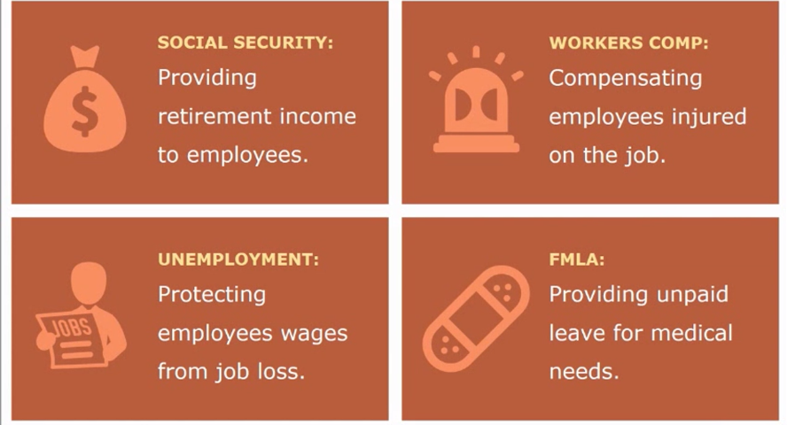
Statutory Benefits
Mandatory or required to give by law

Slide 7
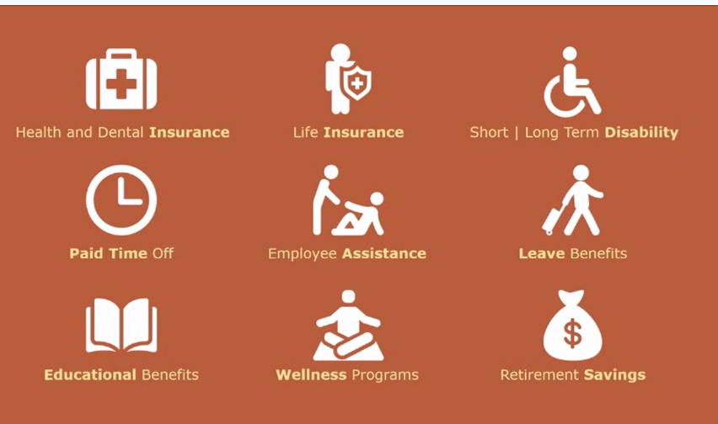
Discretionary Benefits
Voluntary or optional – part of employment package

Slide 8
Go to Google Classroom and Complete the Ed Puzzle: Employee Benefits
Must be completed this hour.

